Slide 1
Bude Infants Writing Journey
Year 1 planning

Slide 3
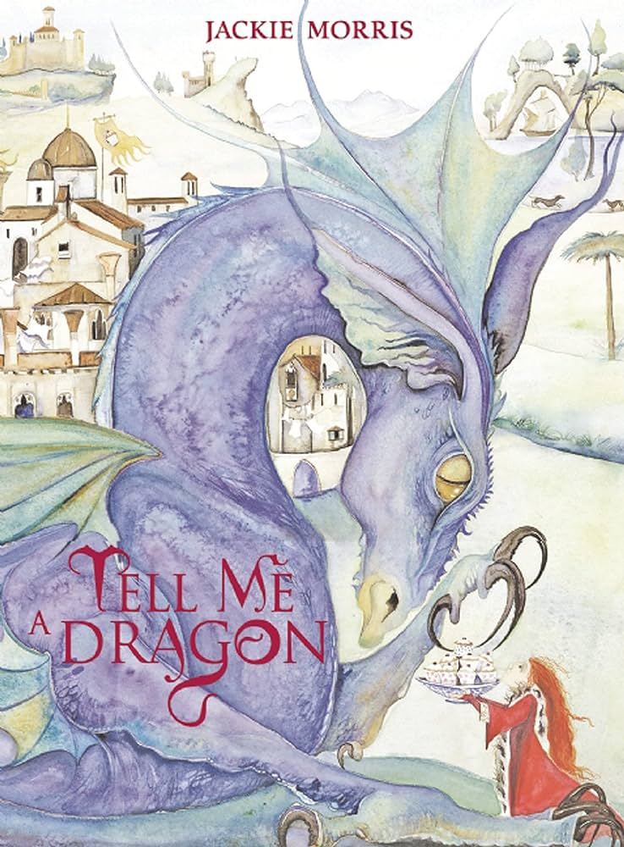
Non-Chronological Report- Dragons.
Linked text

Slide 4
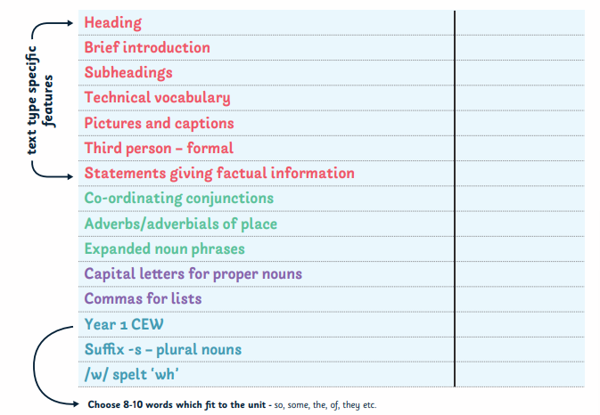
Checklist for the unit

Slide 5
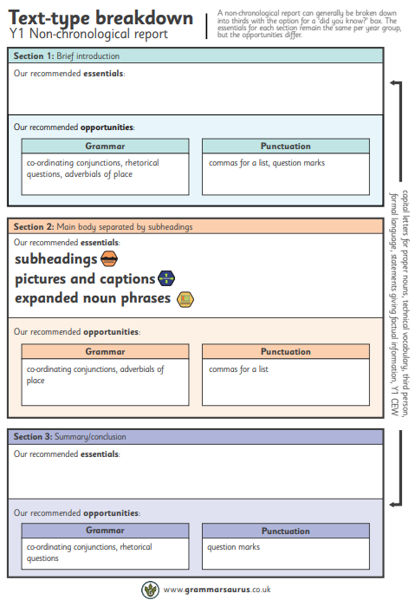
Text-type breakdown for the unit.

Slide 6
Spelling check
Co-ordination conjunctions to join clauses (and) check
Commas in a list check
Expanded noun phrase check
Capital letters for proper nouns check
Adverbs/adverbials of place check
Question mark check.

Slide 7
Day 1
Children to complete a spelling test in their book.
Use diagnostic test resource

Slide 8
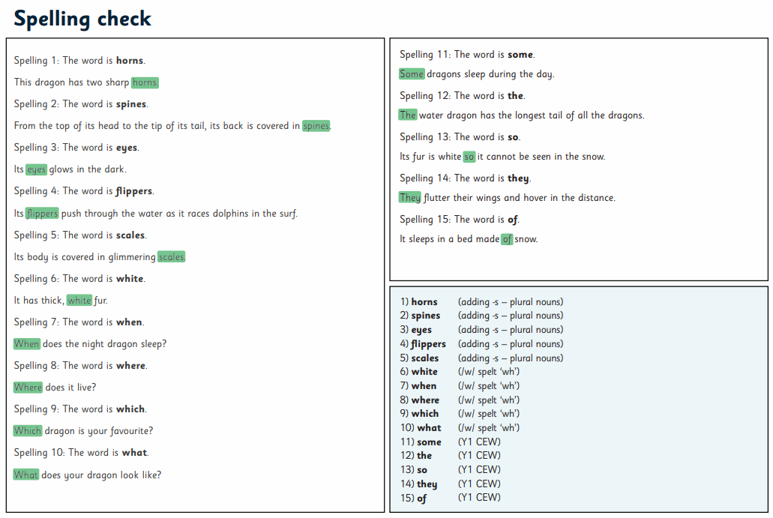

Slide 9
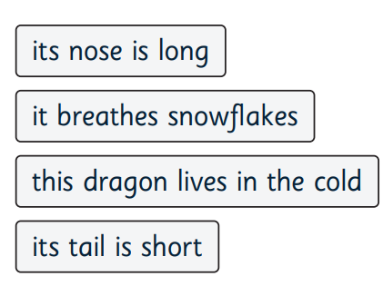
Co-ordinating conjunctions
What word could you use to join these clauses.
its nose is long its tail is short
this dragon lives in the cold it breathes snowflakes

Slide 10
Commas in a list
Can you finish this sentence with a list of three things a dragon eats.
This dragon eats

Slide 11
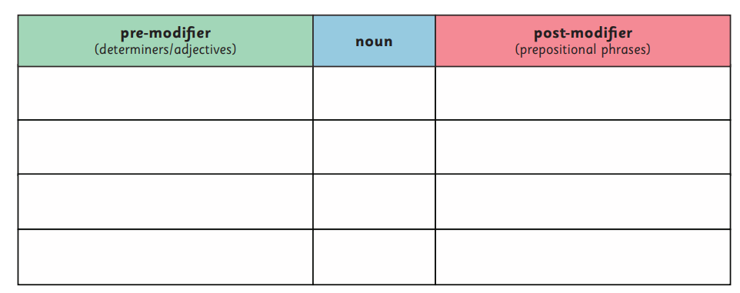
Expanded noun phrase
Use this grid to expand on the nouns.

Slide 12
Capital letters for proper nouns
Can you punctuate the sentences with capital letters.

Slide 13
Adverbs/adverbials of place
Add in the following information to the independent clause.
Where did the dragon collect eggs?

Slide 14
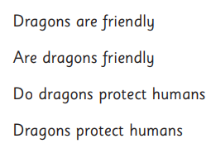
Question marks
Punctuate these sentences with either a full stop or a capital letter.

Slide 15
Day 2
Use dragon model text and castle of the united kingdom model text.
Put these in insert whiteboards
Put children in pairs
One with dragon one with castles
Looking at the features of a non-chronological report.

Slide 17
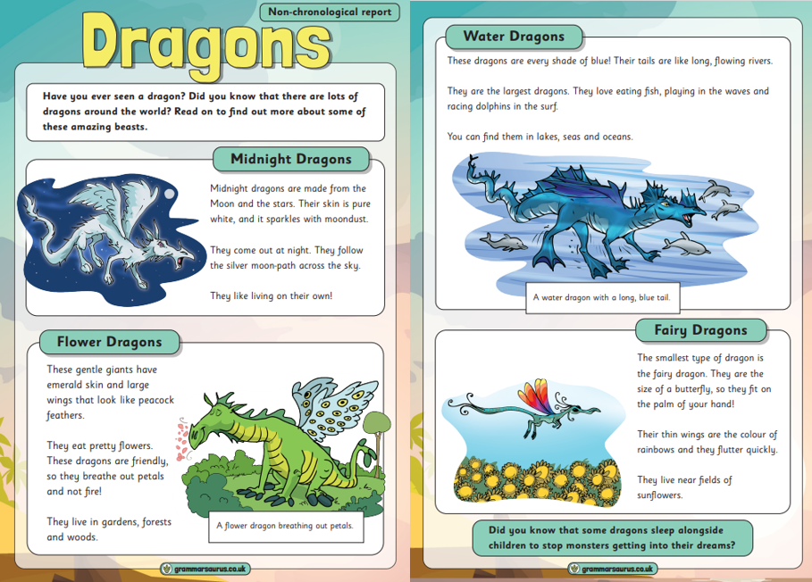
Model text
The purpose of this text type is to document and store information about a topic.
Look at the model text- we are not going to read it. Have model text printed and put in insert whiteboards.
How is the writing organised?
Are there any headings or sub-headings?
Are there any pictures or diagrams?

Slide 18
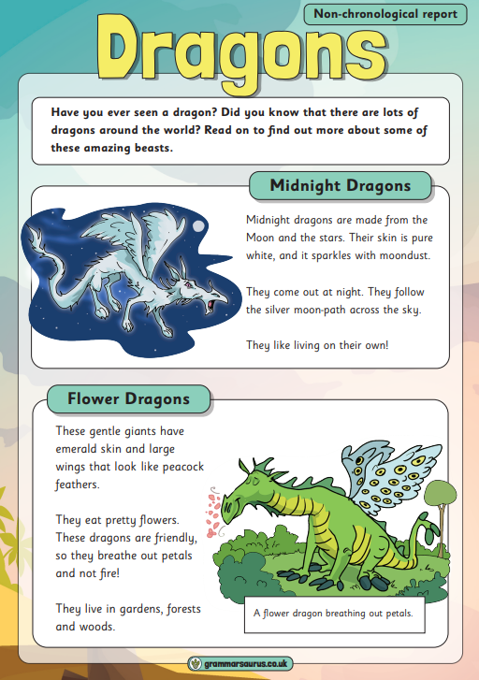
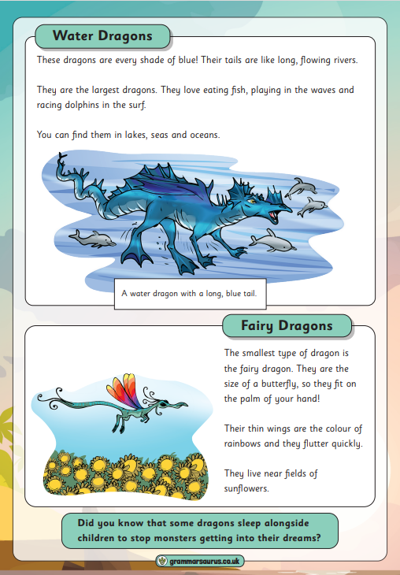

Slide 19
Spot the difference
What is it and what is its purpose?
On the next slide ask children to identify what is different between the 2 texts.

Slide 21
Explain
Heading- tells the reader what they are going to be reading about.
Ask children to circle the heading on the dragon text.

Slide 22
Ask children to circle the heading on this text.

Slide 24
Heading- tells the reader what they are going to be reading about.
Introduction- Introduces the topic of the report. It gives the reader an idea of what to expect in the rest of the report.
Can you circle the introduction on the dragon text.

Slide 27
Heading- tells the reader what they are going to be reading about.
Introduction- Introduces the topic of the report. It gives the reader an idea of what to expect in the rest of the report.
Sub-heading- Used to organise information into groups and tells the reader what they can expect to read about in that section.
Can you circle the sub-heading on the dragon text.

Slide 29
Cosy Read
Teacher to read the model text to the children.
Children to follow it along with their partner.
Can they now find all the subheadings?
What else is included in the text that makes it stand out?

Slide 30
Touch on this but don’t spend long. They need to know that non-chronological reports are written in the third person. They are not writing about themselves.

Slide 31
Heading- tells the reader what they are going to be reading about.
Introduction- Introduces the topic of the report. It gives the reader an idea of what to expect in the rest of the report.
Sub-heading- Used to organise information into groups and tells the reader what they can expect to read about in that section.
Third person- A non-chronological report is written in the third person because the writer is writing about someone (or something) other than themselves

Slide 33
Read this to the children and ask which one sounds better and why. They should say that the author knows what they are talking about.

Slide 34
Heading- tells the reader what they are going to be reading about.
Introduction- Introduces the topic of the report. It gives the reader an idea of what to expect in the rest of the report.
Sub-heading- Used to organise information into groups and tells the reader what they can expect to read about in that section.
Third person- A non-chronological report is written in the third person because the writer is writing about someone (or something) other than themselves
Technical vocabulary- must be used so that the reader can understand the non-chronological report.

Slide 35
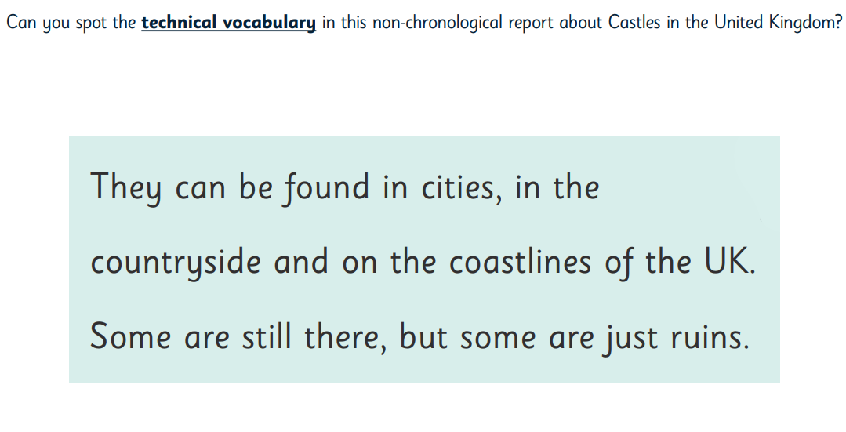

Slide 36
Day 3

Slide 38
Section 1- Introduction Co-ordinating conjunctions to join clauses (and)

Slide 39
1. Provide children with following independent clauses.
Follow Place Value of punctuation structure
dragons
are
friendly creatures
dragons
have
a bad reputation
many kinds of dragon
exist
Model finding subject, verb and any left overs (drawing an arrow pointing to the clause they belong to.)

Slide 40
2. Independent application
Use resource children to continue prior learning of PVOPG to complete this activity independently.

Slide 41
Day 4

Slide 42
Starter
Can you write me a sentence about this dragon.

Slide 43
Let’s look at the sentence we did yesterday…
Dragons are friendly creatures. Dragons have a bad reputation. Many dragons exist.
3. These sentences would be perfect for an introduction!
They give information about dragons in general.
They do not give information about any specific dragon.

Slide 44
4. and
Introduce ‘and’ which can be used to join two simalar sentences together.
and can be used to join two independent clauses that are similar ideas, the second clause adds more information of a similar kind to the first clause.

Slide 45
5. Concrete resources to print

Slide 46
Model
Cut out a red clause which blue clause sounds similar? Stick one side of flip chart stick blue other side. Stick the and in the middle to join and read it outloud.
We will choose on of each of the red clauses to add to one of each of the blue clauses using ‘and’
“Dragons are friendly creatures”
Which of the blue clauses could we join “dragons are friendly creatures” using ‘and’?
We are using ‘and’ to join similar ideas, the second clause must add more information of a similar kind to the first.
Read each possible pairing aloud, re-arranging the clauses as you do so.
Speak your thoughts aloud, giving reasons for either rejecting or accepting each pairing.

Slide 47
6. Independent application
Children to cut and stick with ‘and’ to join sentences.

Slide 48
Day 5
Look at your flip chart example of the sentences put together using ‘and’.
Today we are going to write out the sentences.

Slide 49
7. Model the punctuation of a multi-clause sentence.
Model the writing of this sentence in its abstract form on flip chart, speaking your choices aloud as you do so.

Slide 50
8. Model the writing of this sentence in its abstract form on flip chart, speaking your choices aloud as you do so.
Children to use their work from yesterday to write the sentences in its abstract form. Making sure they are using ‘and’ to join the two sentences together.

Slide 51
Day 6

Slide 52
9. Dragons are friendly creatures and dragons love people.
Explain today we are going to be making our introductions better and not as clunky. Read the sentence below from your flip chart.
What word has been repeated?
Which pronoun could we use to avoid repeating the noun ‘dragons’
he
she
they
we
it

Slide 53
10. Re-write the sentence replacing repeated word with a pronoun.
What does ‘they’ refer to?

Slide 54
11. Independent application
Re-write the remaining two sentences replacing any repeated words with a pronoun.
First sentence has been modelled by teacher.
Second sentence children do on the carpet on whiteboards and guidance.
Third sentence independent in book.
Photograph of whiteboard sentence to stick in bookl

Slide 55
Day 7

Slide 56
12. Dragons are special creatures and
This is perfect for our introduction because it gives information about dragons in general. It does not give information about any specific dragon.
When we use ‘and’ to join two independent clauses that are similar ideas, the second clause often adds more information of a similar kind to the first clause.
What more information of a similar kind could we add to this first clause?

Slide 57
Model
Generate ideas in talk partners and expand on vocabulary.
Write on flip chart “Dragons are special creatures” (what could make dragons special?)
When you are happy with ideas model writing next part of the sentence orally vocalising ‘and’ and ‘they’ pronoun choice.
Dragons are special creatures and they have special abilities.

Slide 58
13. Guided write
Some dragons are big and
Again, as a class generate lots of ideas. This time children to write the sentence on their whiteboard so it is guided by teacher.
Take picture of children's whiteboards.

Slide 59
Independent write
Some dragons are pets and they
Dragons make great friends and they

Slide 60
Day 8

Slide 61
14. Model the introduction
Many kinds of dragon exist and every dragon is different.
They are special creatures and they have special abilities.

Slide 62
15. Introduction
Children to write the introduction to their non-chronological report about dragons with a focus on the co-ordinating conjunction ‘and’. Dependent on assessment, they may do so independently, in pairs or with support of an adult. Some children may draw upon ideas from all previous sentence work. Some children may develop their own ideas.

Slide 63
Section 2- Main body separated by subheadings. Commas in a list
Day 9
On whiteboards practice the formation of commas
,

Slide 64
1. List nouns we can see
Practice adding –s to plural nouns
Teacher to model writing these in a list focusing on using a comma.
Ask children to list nouns they can see from the picture of an ice dragon. Orally emphasis single and plural adding s and explaining “claws because there are more than one claw”
Repeat step for each dragon.

Slide 65
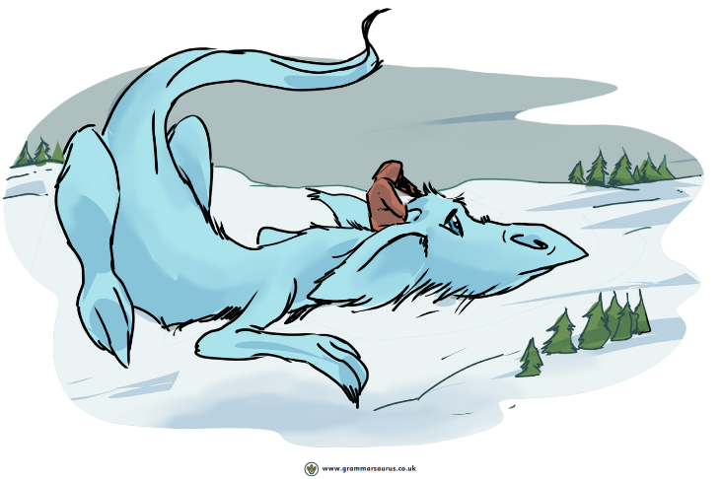
Ice Dragon

Slide 66
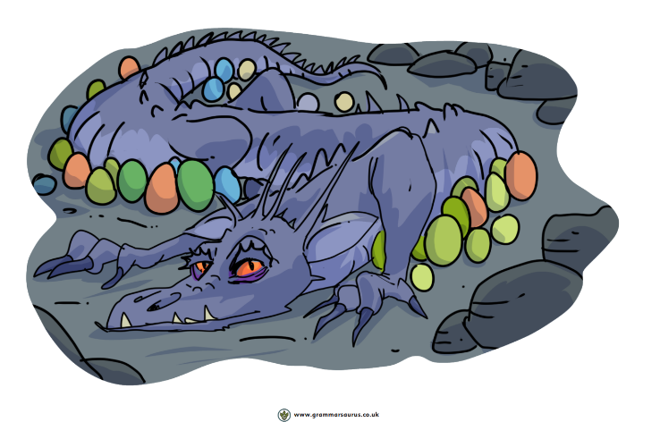
Egg Dragon

Slide 67
Underwater Dragon

Slide 68
Guided write
Ice Dragon
fur, eyes, ears, tail, mane, nose, legs, nostrils, mouth

Slide 69
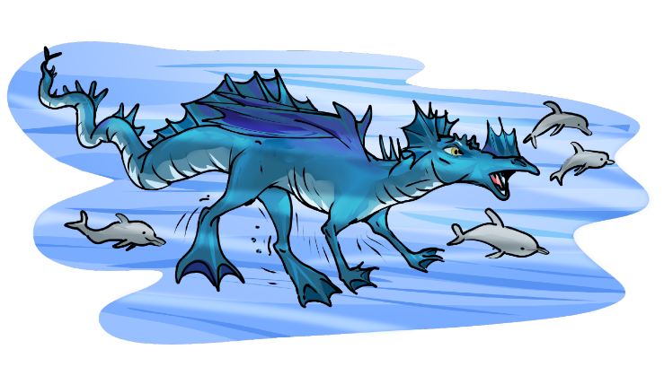
Independent write
Egg Dragon
Underwater Dragon

Slide 70
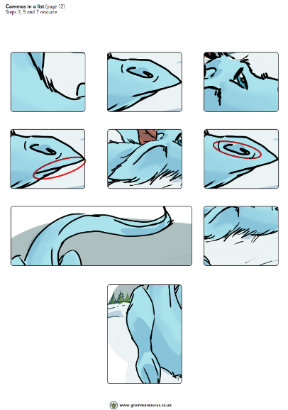
2. Using physical representations of full stops, commas and ‘and’, and pictures to represent three of the physical characteristics of a chosen dragon.

Slide 71
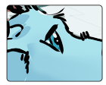
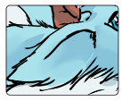
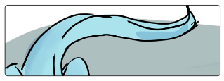
,
Ice dragons have
and

Slide 72
3. Read the sentence aloud including punctuation.
Ice dragons have eyes (comma), ears and a tail (full stop).
My turn your turn.

Slide 73
4. Write the sentence on the board as its being read aloud.

Slide 74
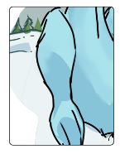
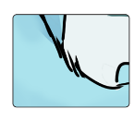
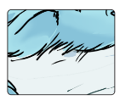
5. Guided
Ice dragons have
Punctuate using cards
Orally say sentence
Write sentence

Slide 75
Independent application

Slide 76
Modifying the noun-expanded noun phrase
With a focus on the ice dragon, list some of the sight nouns (physical characteristics from step 1) in the table. Use the ice dragons picture for support, model the modification of the noun using adjectives (and determiners where appropriate)
A modifier is a word, clause or phrase used to changed the meaning of another word to make it more specific. It gives extra information about a noun.

Slide 77
Model
thick
fur
eyes
ears
tail

Slide 78
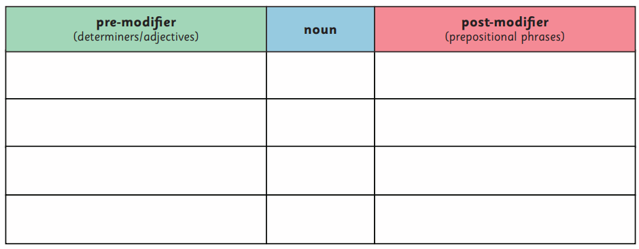
Independent application
Resource to print

Slide 79
7. Explain
We are going to use these expanded noun phrases to add detail and description to our lists.
Use pictures and symbols to show the following sentence.

Slide 80
Orally compose sentence adding modifications.
Ice dragons have blue eyes (comma) floppy ears and a long tail (full stop)
Write the sentence on the board as it is being read out loud.

Slide 81
8. Compare sentences.
Ice dragons have blue eyes, floppy ears and a long tail.
Ice dragons have eyes, ears and a tail.
What do we know from the first sentence that we did not know in the second?
How has detail and description been added to the sentence?

Slide 82
9. Repeat steps 7 and 8 with further examples of the ice dragon using the table in step 6.

Slide 83
Guided write
Ice dragons have thick fur, short legs and a tangled mane.
Use picture prompts and the table to generate ideas.
Model thought process when writing the sentences,

Slide 84
Independent write
Pictorial
Oral
Writing

Slide 85
10. List sight nouns for the egg dragon or the underwater dragon

Slide 86
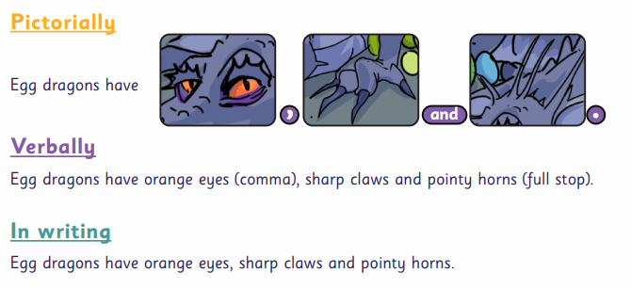
11. Use expanded noun phrases from step 10. Build sentence pictorially then in writing.

Slide 87
Modifying the noun- expanded noun phrases

Slide 88
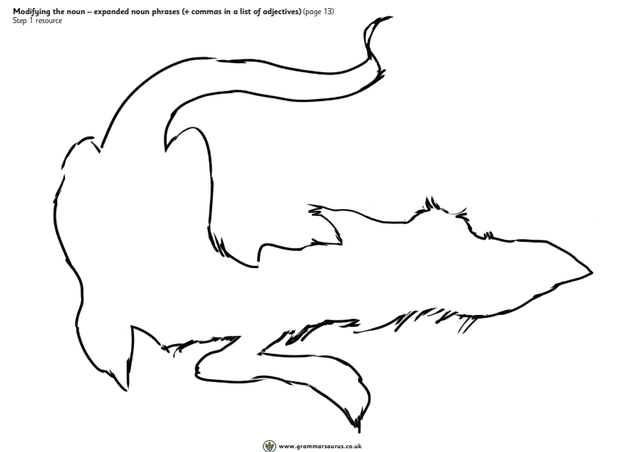
1. Provide this resource

Slide 89
Write the physical characteristics around the outside and adjectives to describe character traits on the inside.
fur
eyes
calm
clever

Slide 91
2. Show the following choosing an adjective from previous task
Verbalise the sentence pointing to the words as they are said.
Ice dragons are friendly dragons.

Slide 92
3. Add to the structure so it reads as follows:
We could modify the noun with two adjectives to add more detail and description. A comma must be used to list these adjectives. Together lets choose another adjective that describes the dragons personality.

Slide 94
Add the expanded noun phrase to the table.
friendly
dragon

Slide 95
Verbalise the sentence.
Ice dragons are kind (comma) friendly dragons (full stop)

Slide 96
Model the sentence in writing
Ice dragons are kind, friendly dragons.

Slide 97
4. Repeat step 3, modelling further examples for the ice dragon.

Slide 98
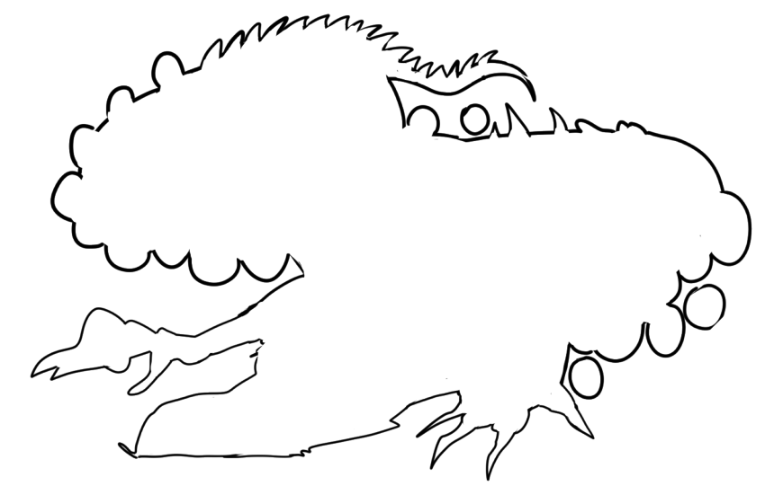
5. Provide children with this resource.

Slide 99
Write physical (nouns) characteristics around the outside.
Claws
Eyes
Ears
Scales
Teeth
Spikes
Tail
eggs

Slide 100
Can we think of some adjective to describe their character?
Kind
Friendly
Loyal
Caring
Loving
generous

Slide 101
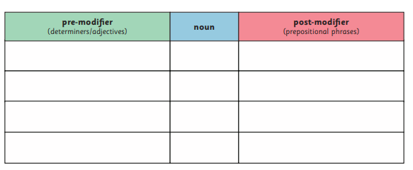
6. Show following structure and repeat step 3 (pictorial, verbal, written) for the egg dragon.

Slide 102
7. Referring to the modelled table from step 3 and the dragon from step 1.
I am going to modify my noun phrase using ‘with’ to add detail and description
The pre-modifiers (adjectives) focus on the dragons personality. I am going to use the post-modifier (with…) to focus on the dragons appearance.

Slide 103
8. Model the post-modification of each noun (dragons) using ‘with’
Say thought process as you go and verbalise the expanded noun phrase within a sentence.

Slide 104
9. Use expanded noun phrases from the table to model application in a sentence.
Children who need more scaffolding to choose only one adjective for post-modifier.

Slide 105
Guided write
Ice dragons are kind, friendly dragons with thick, white fur.

Slide 106
10. Children to use their table from step 6 to build upon their expanded noun phrases with post-modifiers beginning ‘with’ which describes the dragons appearance. Independent write

Slide 107
11. Model write the first two sentences of the section about the ice dragon with a focus on expanded noun phrases and commas in a list
Ice dragons
Ice dragons are kind, friendly dragons with thick, white fur. They have blue eyes, floppy ears and a long tail.

Slide 108
12. Independent write
Children to write the first two sentences about an ice dragon, an egg dragon and/or underwater dragon.
Focus on expanded noun phrases and commas in a list

Slide 109
Capital letters for proper nouns

Slide 110
1. Where does the ice dragon live?
Where does the egg dragon live?
Where does the underwater dragon live?
Look at the book for more inspiration

Slide 111
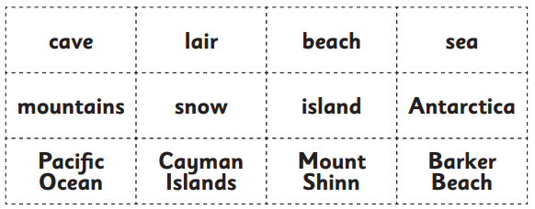
2. Provide the children with following word cards.

Slide 112
Where do ice dragons live?
Where do egg dragons live?
Where do underwater dragons live?
Use your word cards for inspiration.

Slide 113
3.
A common noun refers to a general person, place or thing.
A proper noun refers to a specific person, place or thing.

Slide 114
4. Sort the words from step 2
Can you sort the words into common nouns and proper nouns justifying your choice.

Slide 115
If more work is needed on consolidating common and proper nouns go back to PVOPG

Slide 116
Modifying the verb- adverbs/adverbials of place

Slide 117
1. Let’s look at the following sentence
Ice dragons live. They sleep. Ice dragons fly. They swim.
Can you find all the verbs.

Slide 118
2. We are going to modify the verbs in these sentences to add further description and detail to our writing.
To do this we are going to use adverbials: Where did the verb happen?

Slide 119
3. Can we modify the verb.
Ice dragons live.
What are we modifying?
What is the verb?
Where do ice dragons live?

Slide 120
4. Let’s write the sentence with the addition of the adverbial.
Ice dragons live in Antarctica.

Slide 121
5. According to this sentence, where do ice dragons live?
Ice dragons live in Antartica.
Underline the adverbial of place.
Ice dragons live in Antartica.

Slide 122
6. According to this sentence, where does the ice dragon live? What is the adverbial of place that is modifying the verb? Underline the adverbial of place.
Ice dragons live in caves.
Ice dragons live in the snowy mountains.
Ice dragons live in Antartica.
Challenge
Ice dragons live in caves in the snowy mountains of Antartica.

Slide 123
In books independent application
Ice dragons live

Slide 124
7. Use the second sentence from step 1. Model modifying the verb.
They sleep
What are we modifying?
What is the verb?
Where do ice dragons sleep?

Slide 125
8. Rewrite the sentence with the addition of the modifier. Talk your thoughts as you do it.
Ice dragons sleep
Can you write your own sentence modifying the verb to sleep.

Slide 126
9. According to this sentence where do ice dragons sleep?
Ice dragons sleep under the stars.
Underline the adverbial of place.

Slide 127
10. According to these sentences, where does the ice dragon sleep? What is the adverb/adverbial that is modifying the verb?
Ice dragons sleep on snow beds.
Ice dragons sleep under the stars.
Challenge
Ice dragons sleep on snow beds under the stars.

Slide 128
11. Provide children with the next independent clause from step 1.
Ice dragons fly.
What are we modifying?
What is the verb?
Where do ice dragons fly?

Slide 129
12.
They swim
What are we modifying?
What is the verb?
Where do ice dragons swim?

Slide 130
13. Display class text we have written so far. Continue the model with a focus on adverbials of place and capital letters for proper nouns.

Slide 131
14. Independent
Write about where your dragon lives and what it does focusing on adverbials of place and capital letters for proper nouns.

Slide 132
Section 3- Summary/conclusion
Prior to this lesson recap the formation of a question mark.,

Slide 133
1. Guess the dragon
Display the six dragons on the next slide.
I am going to choose a dragon but I’m not going to tell you which one. You are allowed to ask questions to try and guess the dragon.
Teacher to scribe questions on the board.

Slide 135
2. Let’s have a look at the questions I have written on the board.
Read through each question ensuring you are saying the punctuation (question mark)
Children to repeat.
Circle each of the question words used.
Add these words to the working wall.
Play the game again challenging children to use question words.

Slide 136
Your turn to play
With your talk partner, one chooses a secret dragon the other has to ask questions to guess.
Make sure to say the punctuation at the end of your question.
Swap.

